Slide 1
Active Learning at Social Distance
Leanna Duncan

Slide 2
Notes:
And it’s something we should be concerned about-- Even if people quibble about the %, the bottom line is that DOING in class is a powerful aid to RETENTION
Key point– the top is a lot EASIER to do at distance than the bottom.

Slide 3
Think of the best discussions you’ve had…
What words describe them?
What did leaders or participants do to make them successful?
How can you make these features appear in a class you teach?
Notes:
I want to hone in on the discussion aspect because this is the main challenge– how to help students talk to each other.
[After discussion of this, maybe in Jamboard?]– There are two main reasons why discussion-based active learning are really helpful--

Slide 4
Create the Environment
Set expectations
Consider pre-research
Facilitate and remember goals
Notes:
From Ava– Facilitating is like being a good host.
Use syllabus/policies wisely
Not just a list of rules or a contract; a sneak preview of what is coming
Find what works for you and for your students
How does this differ online? Specificity, clarity, and lasting existence of the materials.
Take a moment to think about how you might want to deal with difficult topics/conversations. Ex. Historical language.
These conversations can be challenging to have online bc of the above concerns.

Slide 5
Try on Ideas
Notes:
These activities let students try on ideas before committing to them– whether in a paper or in their larger worldview.

Slide 6
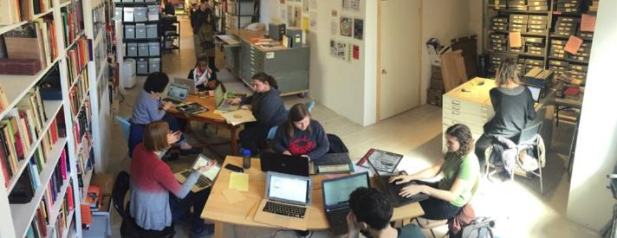
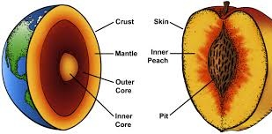
Practice Makes Perfect(ish)
Notes:
Discussion lets people practice how to do the topic in a low-stakes way (note question from someone in their prework for session 3 re. difference between formative assessment and learning activity– key being they are not totally dissimilar but one is more focused on the learning, the other on the role of measuring the learning.
1. Practicing Role play– be the engineer, the historian, the sociologist, the problem-solver.
2. working Analogy– do a thing that has similarities with the thing you are talking about. Useful for more abstract or unfamiliar concepts.

Slide 7
Social Distancing Activity Chart
In Jamboard, add a sticky suggesting how to adapt that activity. Use the chart, or suggest your own ideas!

Slide 8
Activity Card Set

